Slide 1
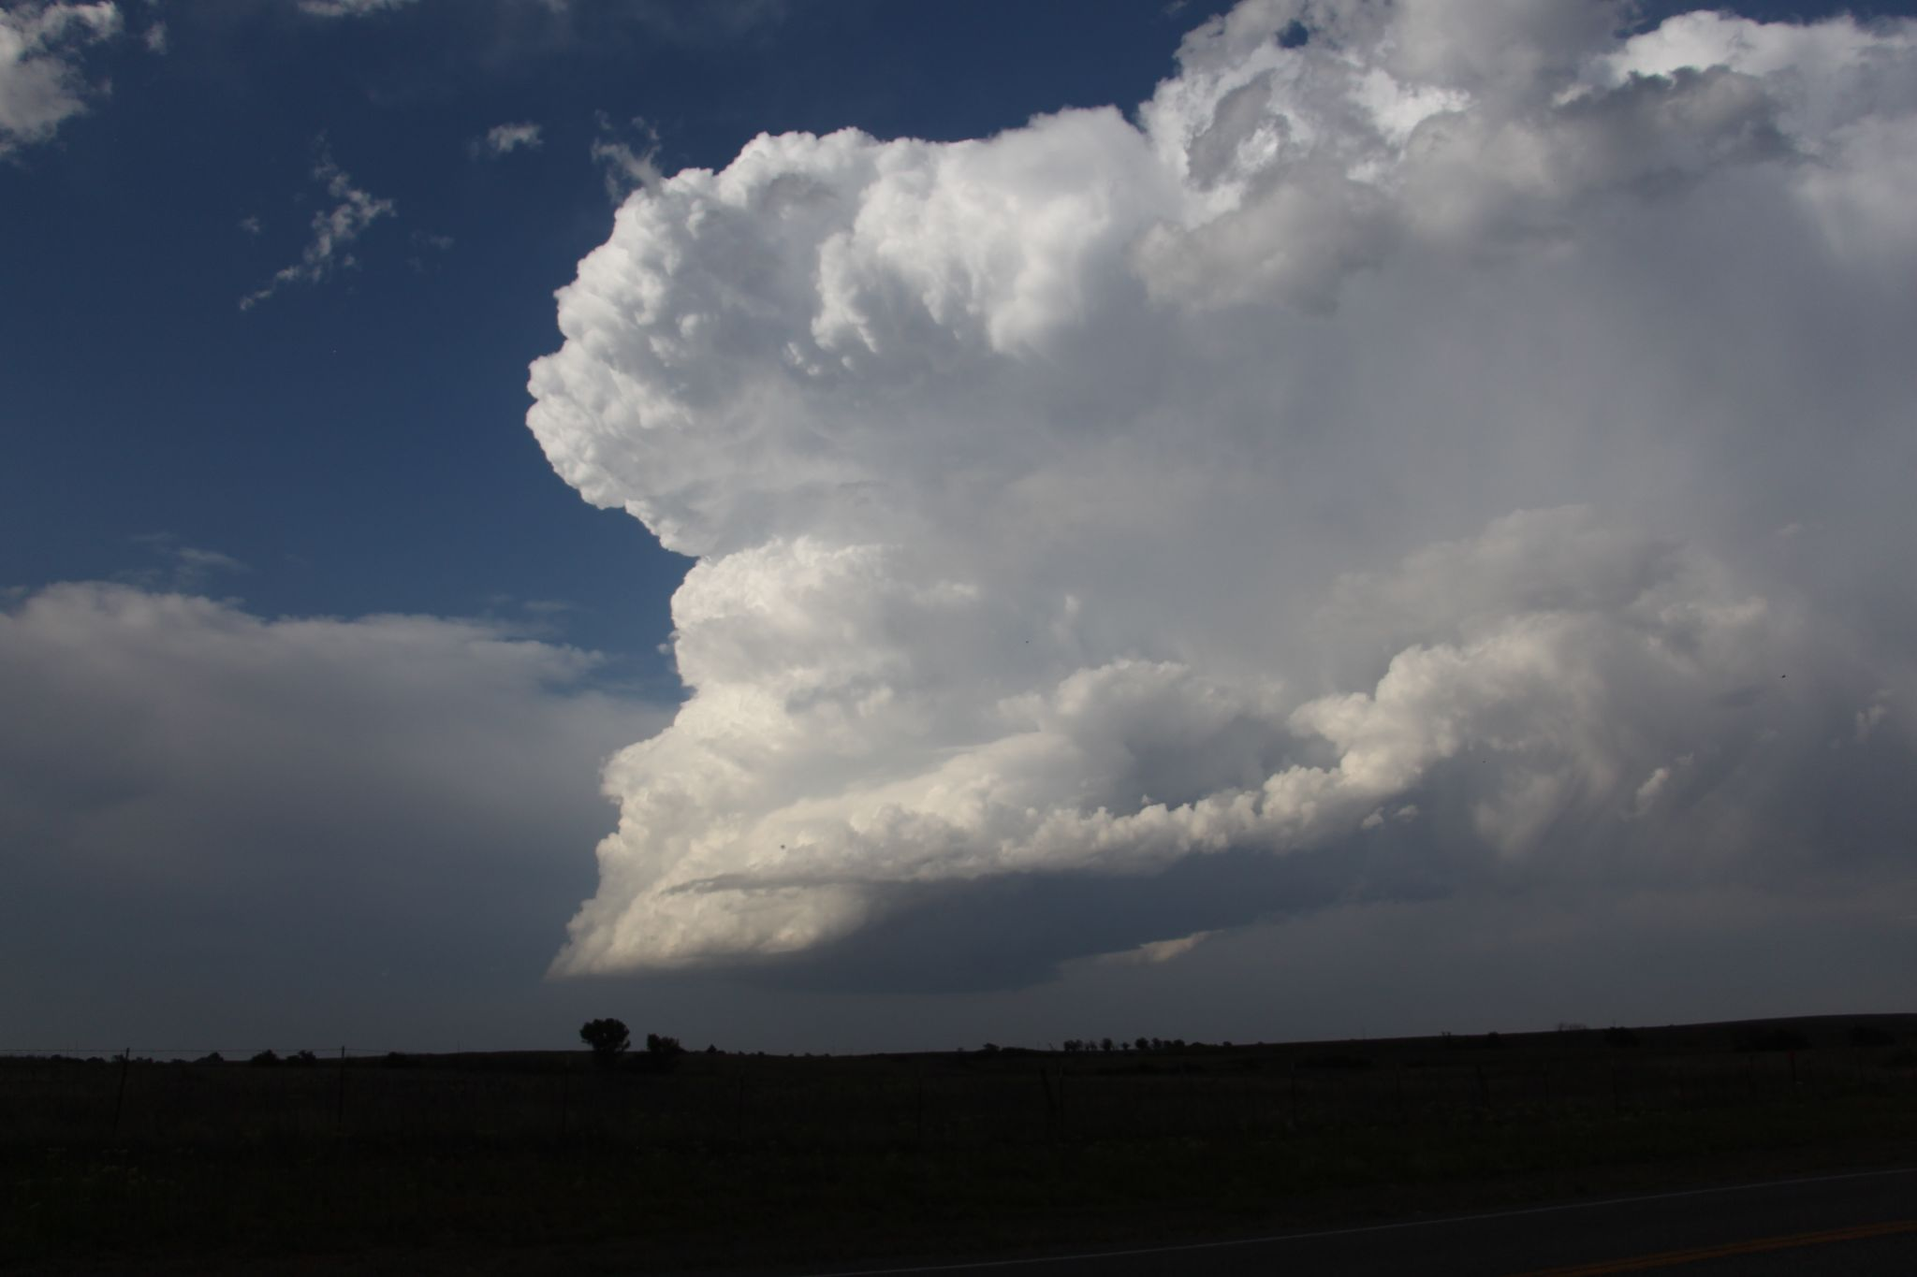
Lapse Rate Tendency
Material by Rich Thompson, Ariel Cohen, Andrew Moore, Tom Galarneau
Photo by Andrew Moore

Slide 2
Why do we care about lapse rates?
Helps generate buoyancy (influences T-storm intensity)
Influences convective initiation (Houston and Niyogi 2007)
Influence precipitation intensity (Takemi 2009)

Slide 3
Lapse rates in most T-storm environments will be conditionally unstable…
In other words, between the dry adiabatic lapse rate (9.8 C/km) and the moist adiabatic lapse rate.
Absolutely Stable
Conditionally Unstable
Moist Adiabat
Dry Adiabat
Absolutely Unstable
LFC

Slide 4
Lapse rates in most T-storm environments will be conditionally unstable…
In other words, between the dry adiabatic lapse rate (9.8 C/km) and the moist adiabatic lapse rate.
Compare the CAPE profiles for these three environmental lapse rates. What are the implications for updraft acceleration?
(Recall: Wmax = sqrt(2*CAPE))
Absolutely Stable
Absolutely Unstable
LFC

Slide 5
How do lapse rates change?
Horizontal lapse rate advection
Influence of lift/stretching
Local change in lapse rate =
Differential Thermal Advection
Diabatic Heating

Slide 6
Lapse Rate Tendency
What physical processes alter the environment lapse rate?
Start with 1st Law of Thermodynamics
This is an important point!
Our ability to anticipate changes in lapse rate derives directly from the first law of thermodynamics!
temperature
pressure
heating
rate
specific
heat
time

Slide 7
Lapse Rate Tendency
What physical processes alter the environment lapse rate?
Start with 1st Law of Thermodynamics
temperature
pressure
heating
rate
specific
heat
time
Expand full derivatives and assume hydrostatic conditions (OK for synoptic and mesoscale)
Local change in temperature with time
Horizontal temperature advection
Vertical temperature advection
Local change in pressure
Horizontal pressure advection
Vertical pressure advection

Slide 8
Lapse Rate Tendency
What physical processes alter the environment lapse rate?
Start with 1st Law of Thermodynamics
temperature
pressure
heating
rate
specific
heat
time
Expand full derivatives and assume hydrostatic conditions (OK for synoptic and mesoscale)
Relatively small
Assume that the hydrostatic approx applies

Slide 9
Lapse Rate Tendency
What physical processes alter the environment lapse rate?
Start with 1st Law of Thermodynamics
temperature
pressure
heating
rate
specific
heat
time
Expand full derivatives and assume hydrostatic conditions (OK for synoptic and mesoscale)
Relatively small,
assume hydrostatic

Slide 10
Lapse Rate Tendency
What physical processes alter the environment lapse rate?
Start with 1st Law of Thermodynamics
temperature
pressure
heating
rate
specific
heat
time
Expand full derivatives and assume hydrostatic conditions (OK for synoptic and mesoscale)
Relatively small,
assume hydrostatic

Slide 11
Lapse Rate Tendency
What physical processes alter the environment lapse rate?
Start with 1st Law of Thermodynamics
temperature
pressure
heating
rate
specific
heat
time
Expand full derivatives and assume hydrostatic conditions (OK for synoptic and mesoscale)
Relatively small,
assume hydrostatic
Lapse rate tendency equation

Slide 12
Lapse Rate Tendency Equation
A
B
C
D
E
F
We’ll work through each term to understand the physical mechanisms

Slide 13
Lapse Rate Tendency Equation
A
B
C
D
E
F
Term A: local time rate of change of environment lapse rate
(Markowski and Richardson 2010, Fig. 7.3)

Slide 14
Lapse Rate Tendency Equation
A
B
C
D
E
F
Term A: local time rate of change of environment lapse rate
lapse rate increasing at PIT
due to warming below 600 mb
(Markowski and Richardson 2010, Fig. 7.3)

Slide 15
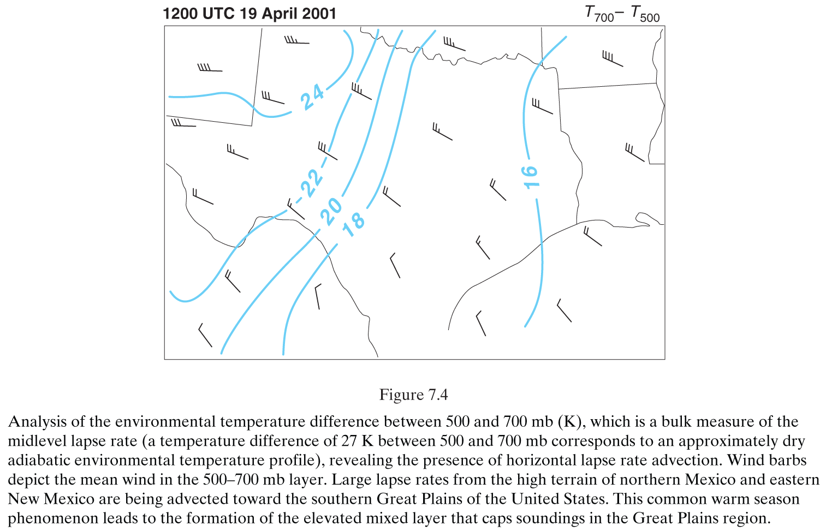
Lapse Rate Tendency Equation
A
B
C
D
E
F
Term B: horizontal lapse rate advection - this one is very important! Let’s take a closer look!
(Markowski and Richardson 2010, Fig. 7.4)

Slide 16
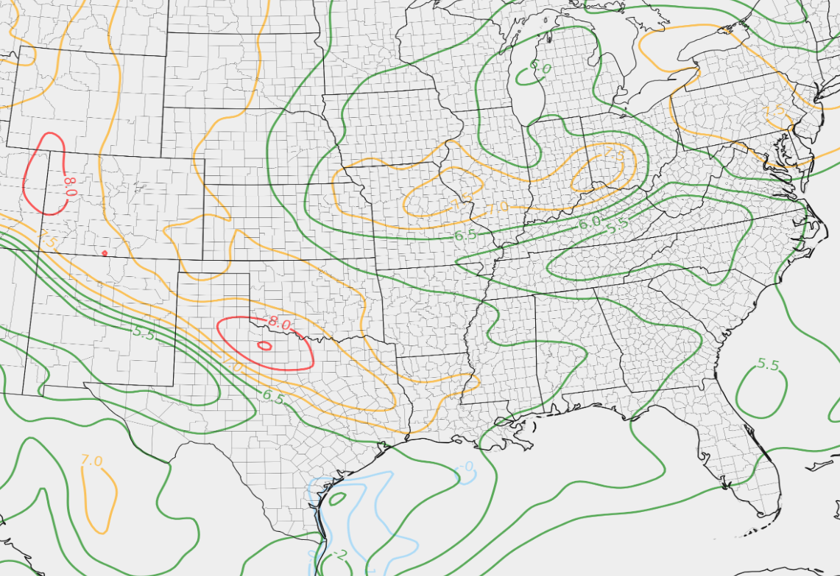
700-500 mb lapse rates
700-500 mb mean wind
Given these wind vectors, what do you expect to happen to the lapse rates at LZK?
LZK

Slide 17
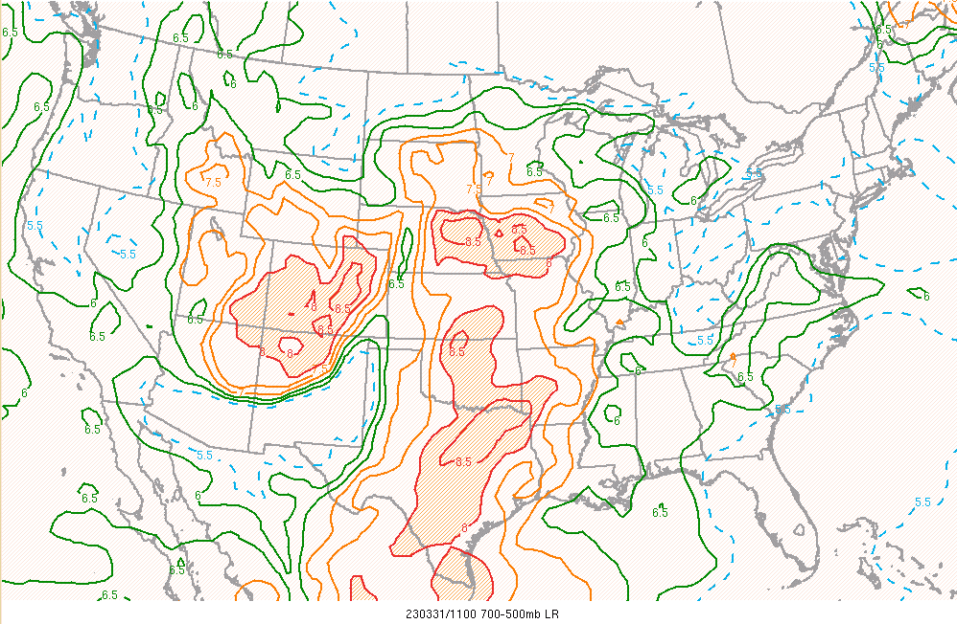
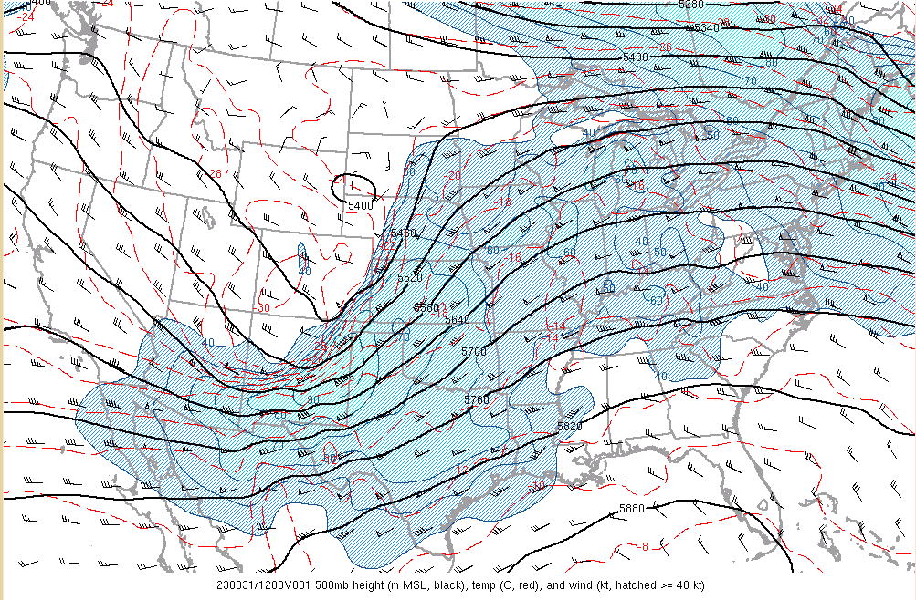
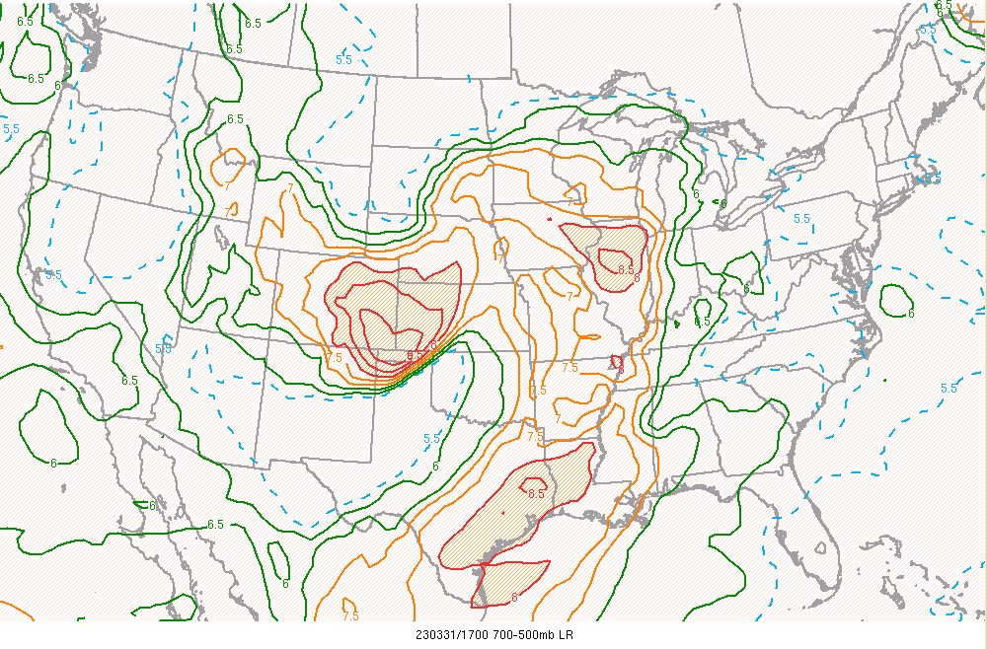
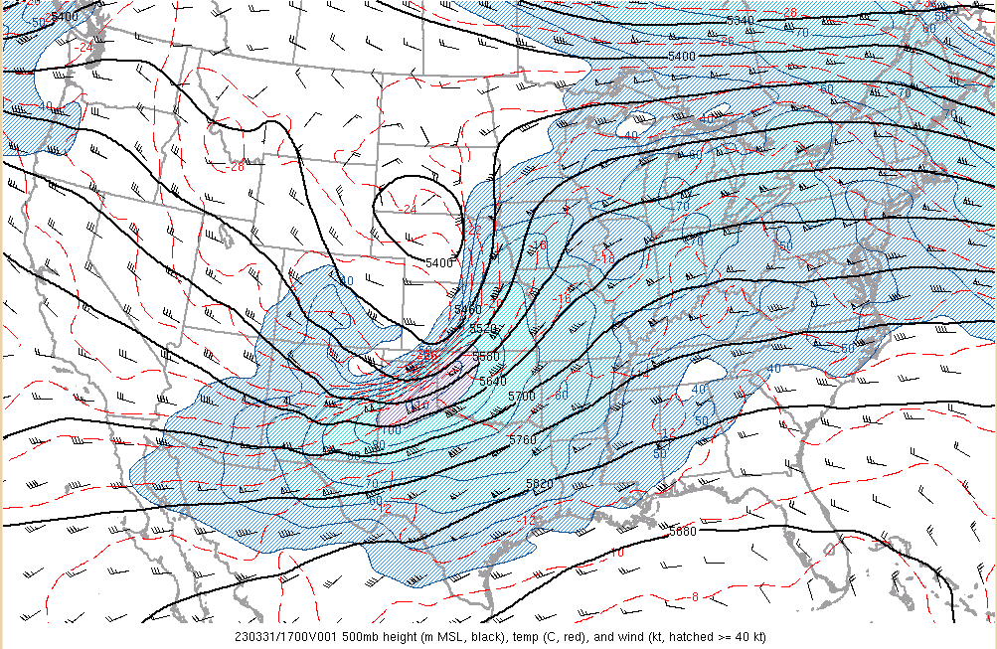
Example from March 31, 2023
Tornado Outbreak

Slide 18
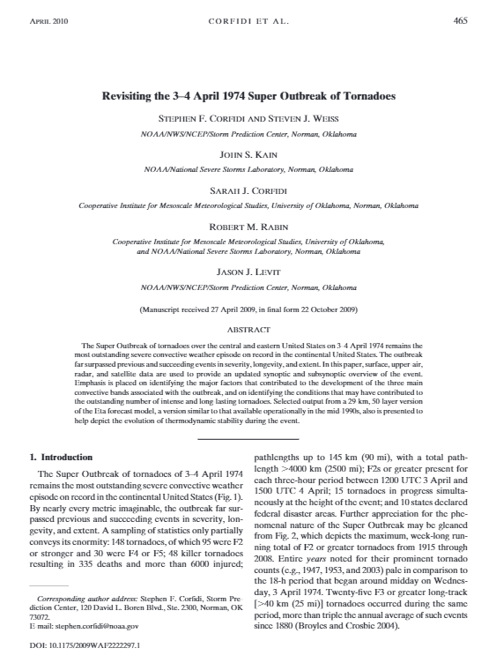
Example from March 31, 2023
Tornado Outbreak
Just like moisture, lapse rates can be tracked days ahead of a severe weather outbreak!

Slide 19
Here’s another example.
Notice the steeper lapse rates upstream at AMA.
Given westerly winds, what do you think will happen to the lapse rates at OUN?
Downstream
OUN sounding
Notice westerly
Flow at AMA
Upstream AMA
sounding

Slide 20
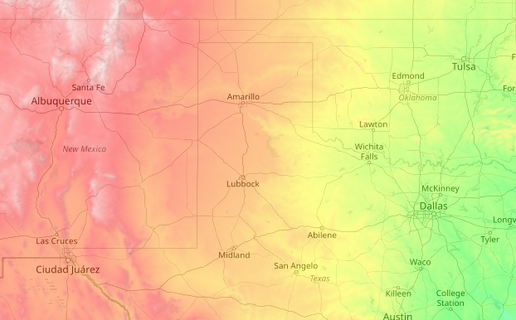
Consider the terrain!
Elevation generally increases as you go west towards the mountains. What would happen if we advected a surface parcel from ABQ to OUN?
ABQ
OUN
5309 ft MSL
1238 ft MSL

Slide 21
Consider the terrain!
Elevation generally increases as you go west towards the mountains. What would happen if we advected a surface parcel from ABQ to OUN?
Parcel is now at a higher altitude AGL!
ABQ
OUN
5309 ft MSL
1238 ft MSL

Slide 22
The last slide was a slight exaggeration of what occurs (parcels can descend in altitude), but illustrates an important point.
The deep, well-mixed boundary layer over the southern Rockies can be advected east over the plains…
And becomes an Elevated Mixed Layer!
OUN-ABQ Terrain Profile
ABQ
OUN
5309 ft MSL
1238 ft MSL

Slide 23
This is an important process for generating steep lapse rates over the Plains, which in turn support large CAPE values.
OUN-ABQ Terrain Profile
ABQ
OUN
5309 ft MSL
1238 ft MSL

Slide 24
Nearly neutral layer
above boundary layer in
Norman noon sounding.
Notice the southwesterly flow in this layer - it likely originated from New Mexico plateau!

Slide 25
Lapse Rate Tendency
Horizontal lapse rate advection
early MAY
Climatology of
surface theta
(and EML)
Lanicci and Warner (1991)
early JUNE
early APR

Slide 26
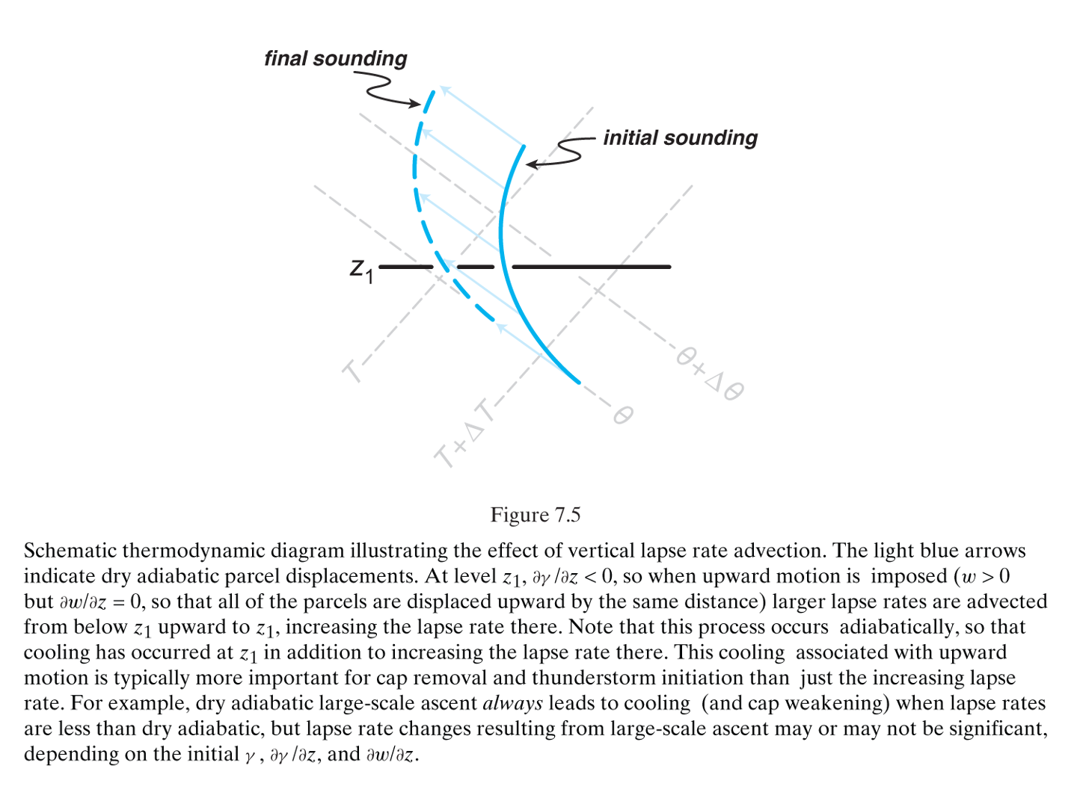
Lapse Rate Tendency Equation
A
B
C
D
E
F
Term C: vertical lapse rate advection
(Markowski and Richardson 2010, Fig. 7.5)

Slide 27
Lapse Rate Tendency Equation
A
B
C
D
E
F
Term C: vertical lapse rate advection
Positive lapse rate advection will contribute to increasing lapse rates
In this case, lapse rates at level z1 increase as steeper lapse rates from below are advected upward
Can be order of magnitude larger than term B on mesoscale
(Markowski and Richardson 2010, Fig. 7.5)

Slide 28
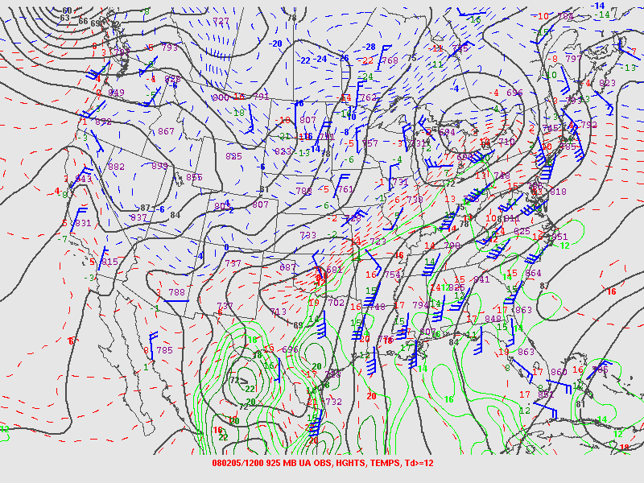
Influence of Lift/Stretching
Influence of persistent lift/stretching
L.R. steepens
L.R. steepens

Slide 29
Influence of Lift/Stretching
Influence of persistent lift/stretching
L.R. steepens
L.R. steepens

Slide 30
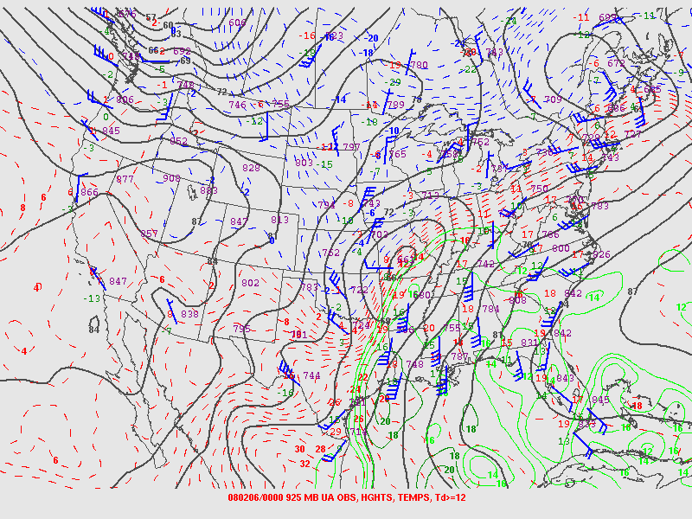
Influence of Lift/Stretching
Influence of persistent lift/stretching
L.R. steepens
L.R. steepens

Slide 31
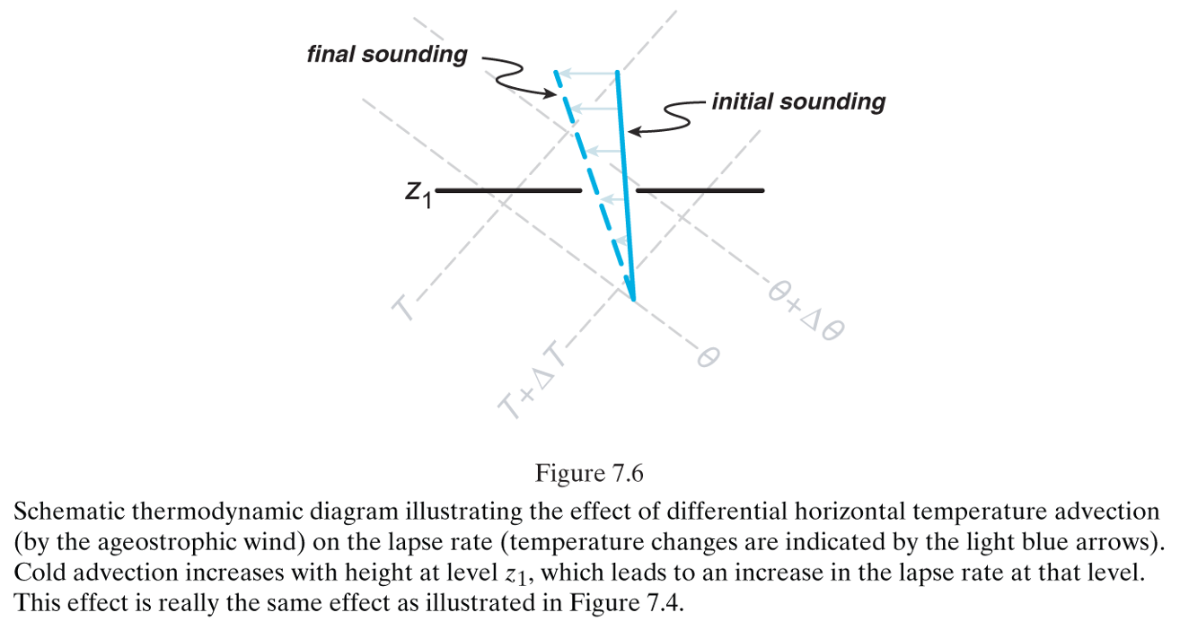
Lapse Rate Tendency Equation
A
B
C
D
E
F
Term D: when combined with term B, this term represents differential temperature advection
(Markowski and Richardson 2010, Fig. 7.6)

Slide 32
Lapse Rate Tendency Equation
A
B
C
D
E
F
Term D: when combined with term B, this term represents differential temperature advection
Lapse rates will increase in situations where cold advection is increasing with height or warm advection is decreasing with height
In this case, lapse rates at level z1 increase in response to cold air advection increasing with height
Can be order of magnitude larger than term B on mesoscale
(Markowski and Richardson 2010, Fig. 7.6)

Slide 33
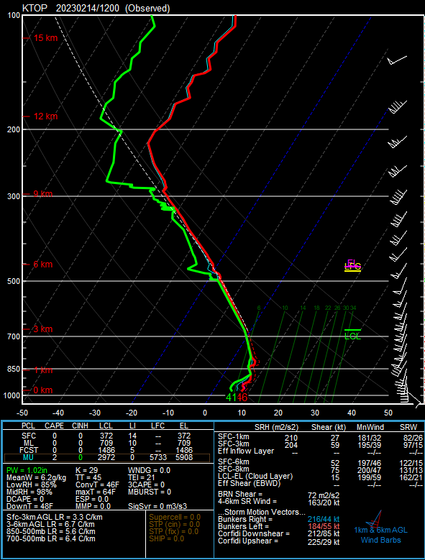
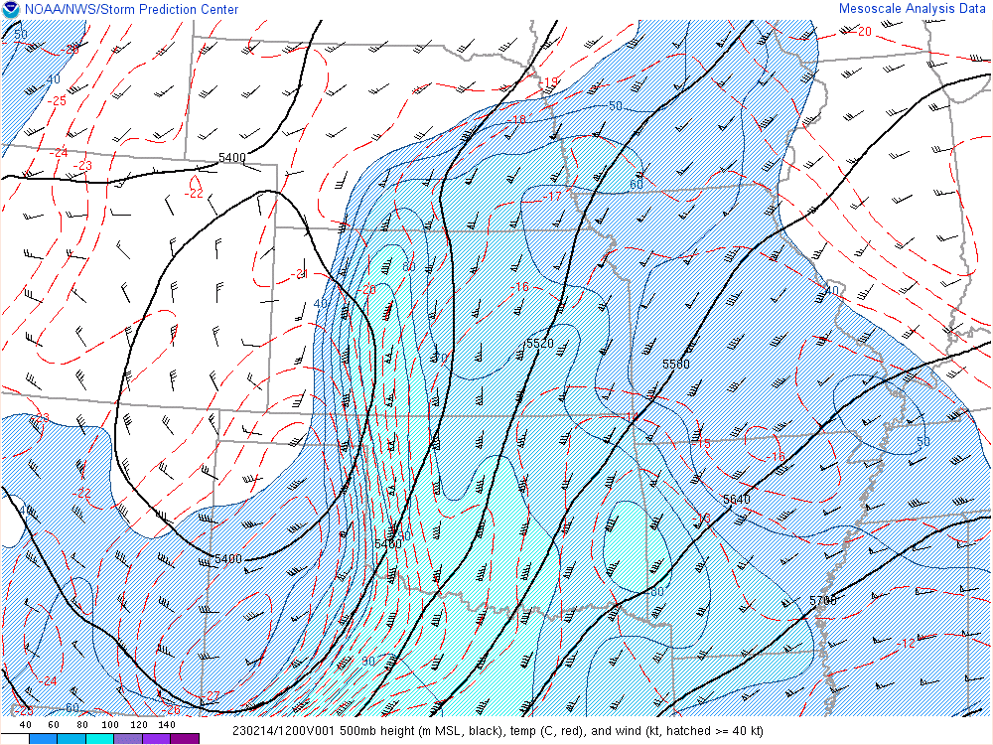
Differential Thermal Advection

Slide 34
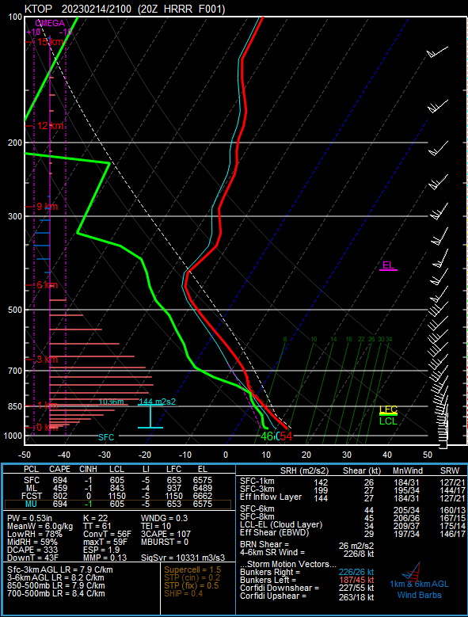
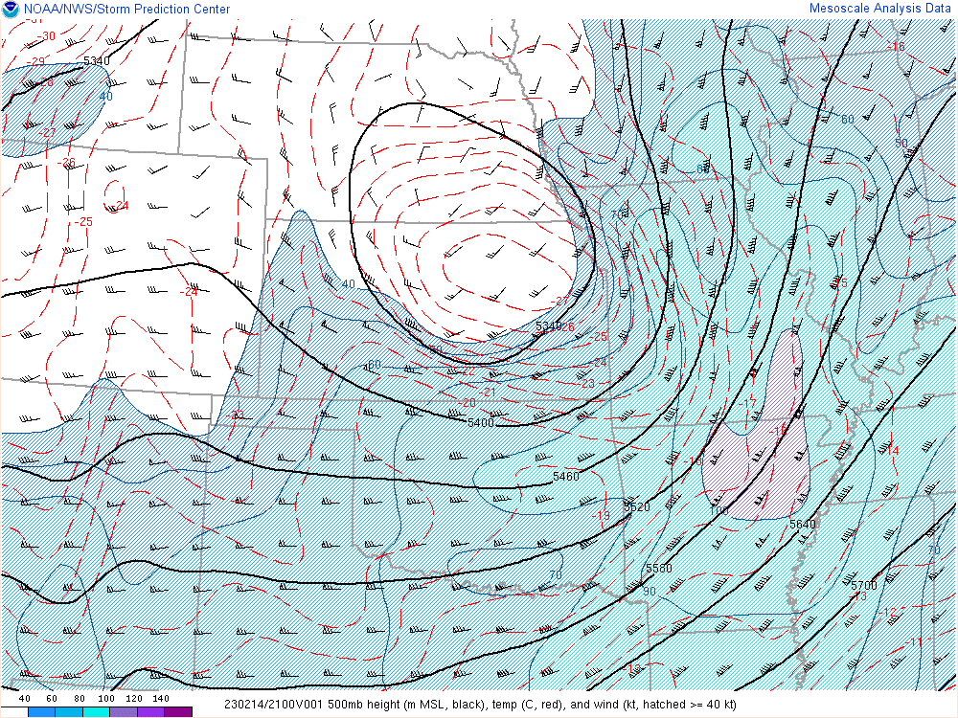
Differential Thermal Advection
Cooling aloft
Warming
down low

Slide 35
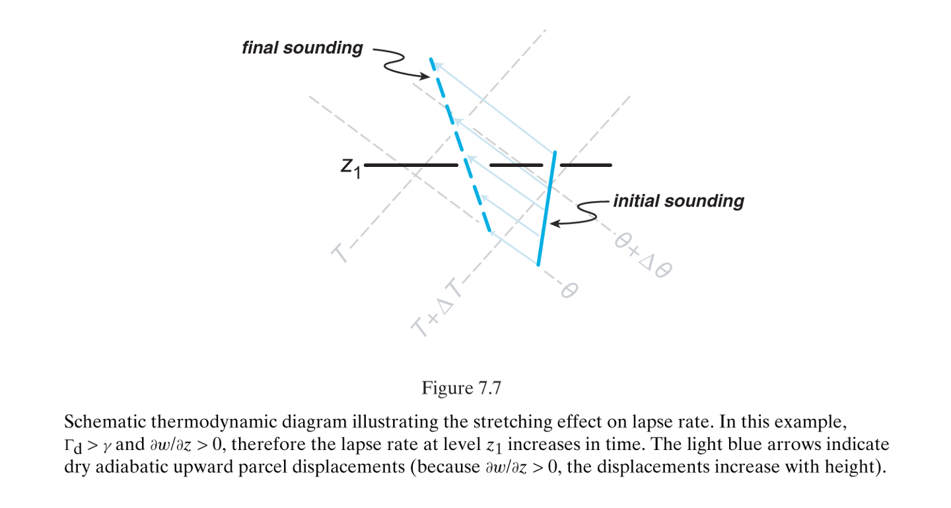
Lapse Rate Tendency Equation
A
B
C
D
E
F
Term E: stretching effect on lapse rate
Stronger ascent = cools faster
Weaker ascent = cools slower
Can be order of magnitude larger than term B on mesoscale
(Markowski and Richardson 2010, Fig. 7.7)

Slide 36
Influence of Lift/Stretching
Influence of persistent lift/cooling
Lift erodes cap

Slide 37
Influence of Lift/Stretching
Influence of persistent lift/cooling
Lift erodes cap

Slide 38
Influence of Lift/Stretching
Influence of persistent lift/cooling
Lift erodes cap

Slide 39
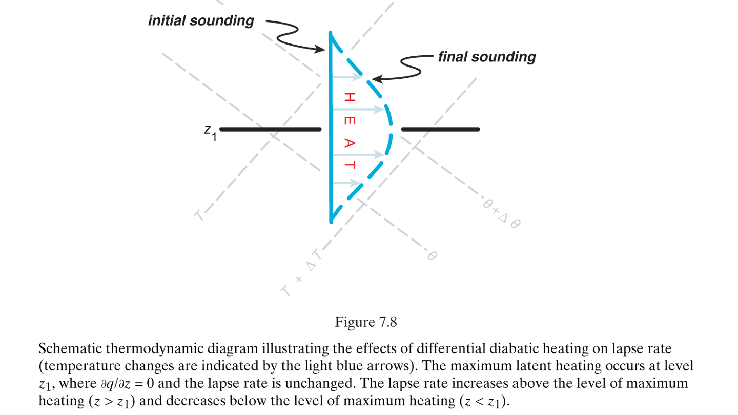
Lapse Rate Tendency Equation
A
B
C
D
E
F
Term F: diabatic heating effect on lapse rate
In this case, in response to a diabatic heating maximum at level z1, lapse rates increase above and decrease below level z1.
Can be order of magnitude larger than term B on mesoscale
(Markowski and Richardson 2010, Fig. 7.8)

Slide 40
Initial Profile
Convection Occurs
Final Profile
Latent heat release warms temperatures
Evaporative cooling lowers temperatures

Slide 41
INFLUENCE OF FAILED CONVECTION
ON THE THERMODYNAMIC PROFILE
Weak ascent supports an initial, isolated updraft

Slide 42
INFLUENCE OF FAILED CONVECTION
ON THE THERMODYNAMIC PROFILE
Dry air entrainment near the capping inversion erodes the updraft.
Updraft may reach LFC, but residual updraft/pressure perturbation is too weak to support further development (turkey tower).
Convective initiation has failed.

Slide 43
INFLUENCE OF FAILED CONVECTION
ON THE THERMODYNAMIC PROFILE
Evaporative cooling in the path of the failed updraft cools/moistens the column.
This leads to a localized reduction in CIN.

Slide 44
INFLUENCE OF FAILED CONVECTION
ON THE THERMODYNAMIC PROFILE
If mesoscale lift continues in this localized area of reduced CIN, subsequent attempts at convective initiation have a higher probability of success!

Slide 45
INFLUENCE OF FAILED CONVECTION
ON THE THERMODYNAMIC PROFILE
Additional Considerations:
It may take multiple attempts at CI to sufficiently reduce CIN.
Consider time of day (is this occurring at 20 UTC (additional diurnal heating expected) or at 00 UTC (peak diurnal heating)?
Strong forcing for ascent can reduce CIN via lift/cooling and/or overcoming cap by lifting parcels to LFC (i.e. is the depth of the lift greater than the LFC?)
Watching satellite trends is vital!

Slide 46
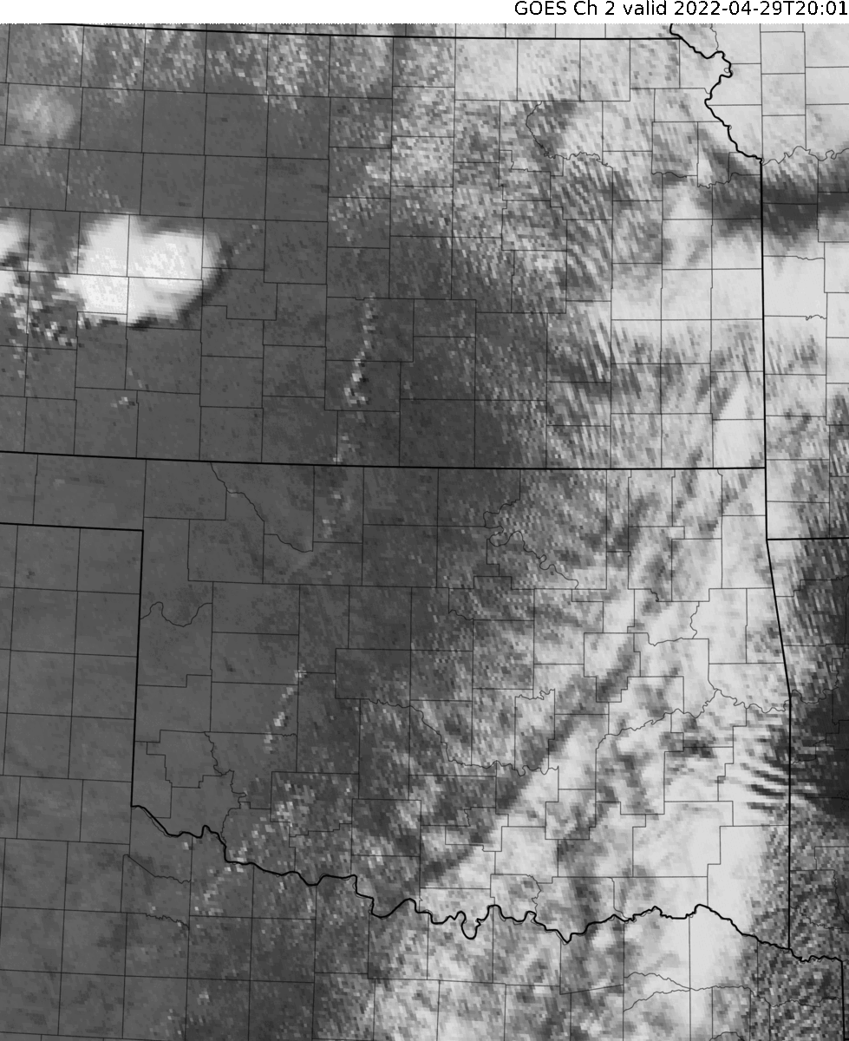
April 29, 2022
In this loop, watch for:
Initial attempts at CI along dryline
Successful CI following the failed attempts
Maturation of tornadic supercells

Slide 47
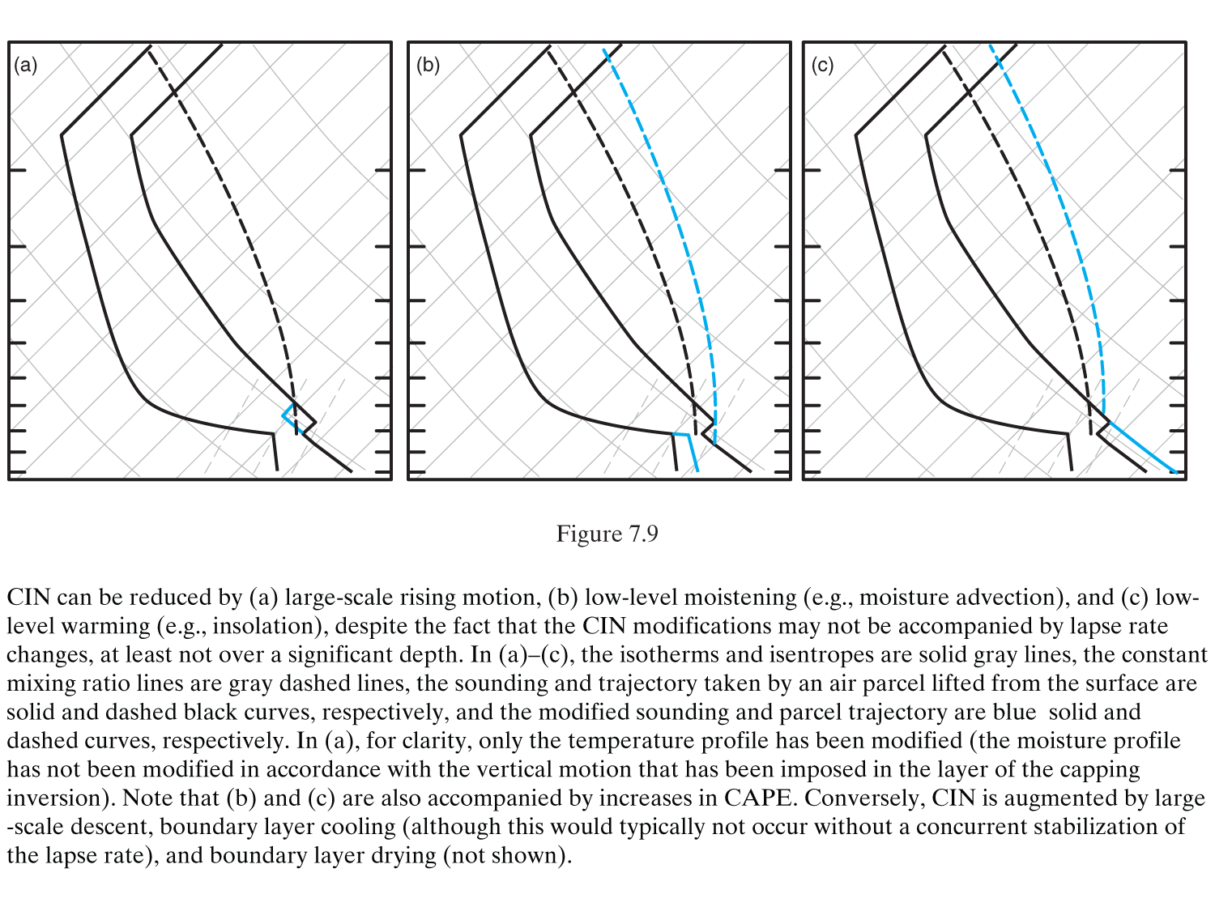
CIN can be reduced and/or CAPE increased by:
Rising motion
Low-Level Moistening
Low-Level Warming
(Markowski and Richardson 2010, Fig. 7.9)

